Slide 1

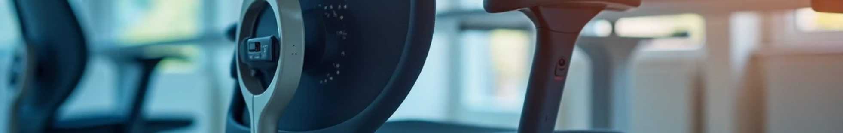
Intelligent Detection of Body Posture
Dilon Brahmbhatt (22BIT236D)
Het Virani (22BIT252D)
Presented to : DR. Amit G Kumar & DR. V VIKAS

Slide 2
Introduction and Motivation
Problem
Poor posture while sitting causes back pain, neck strain, and spinal issues.
Risk is higher for students and office workers who sit for long hours.
Statistics
80% of adults suffer from back pain at least once in their life.
Sedentary lifestyles make posture-related health problems very common.
Motivation
Existing methods (reminders, ergonomic chairs) are expensive or not real-time.
Users need instant alerts to correct posture before it causes harm.
Our Idea
Use Flex + Ultrasonic sensors on the chair to detect posture.
Process data with ESP8266 WiFi module.
Send real-time notifications via Blynk app to encourage healthy sitting habits.

Slide 3




Project Objectives
Continuous Monitoring
Instant Feedback
Deploy ultrasonic and flex sensors for real-time posture detection and analysis of sitting habits.
Deliver immediate alerts via email and mobile notifications to encourage posture correction.
Wireless Solution
Portable Design
Utilize ESP8266 microcontroller for seamless wireless communication and data processing.
Create an affordable, user-friendly system that adapts to various seating environments.

Slide 4
Literature Review & Background Research
Existing Research on Posture Monitoring Systems
Wearable Devices (e.g., posture-correcting vests with accelerometers)
  Real-time posture detection, portable.
  Limitations: Intrusive, uncomfortable for long-term use.
  Ref: Dunne et al., 2008.
Chair-Based Systems (pressure sensors + distance sensors)
  Non-intrusive, good accuracy.
  Limitations: Expensive, fixed installation.
  Ref: Jeong & Park, 2020.

Slide 5
Research Gaps & Innovation Opportunities
Gaps in Existing Systems
Wearables (e.g., Dunne et al., 2008): Accurate but intrusive, not practical for daily use.
Smart chairs (e.g., Jeong & Park, 2020): Good accuracy, noisy in real settings, and limited scalability.
Our Innovations
Low-cost, chair-mounted system using flex + ultrasonics on ESP8266 with noise filtering.
Scalable design: Expandable to 6 sensors + MPU6050 for motion tracking.
Blynk alerts + future cloud storage: Real-time feedback, long-term habit analysis, ergonomic insights.

Slide 6
System Architecture & Methodology
01
02
03
Sensor Integration
Data Processing
Alert Generation
2 Ultrasonic sensors mounted on chair back detect distance variations, while 1 flex sensors monitor thoracic spine curvature for comprehensive posture analysis.
ESP8266 microcontroller applies noise reduction filters and processes sensor values using calibrated thresholds for accurate posture classification.
Real-time notifications sent through Blynk platform via Wi-Fi, delivering instant email and mobile alerts to encourage immediate posture correction.

Slide 7
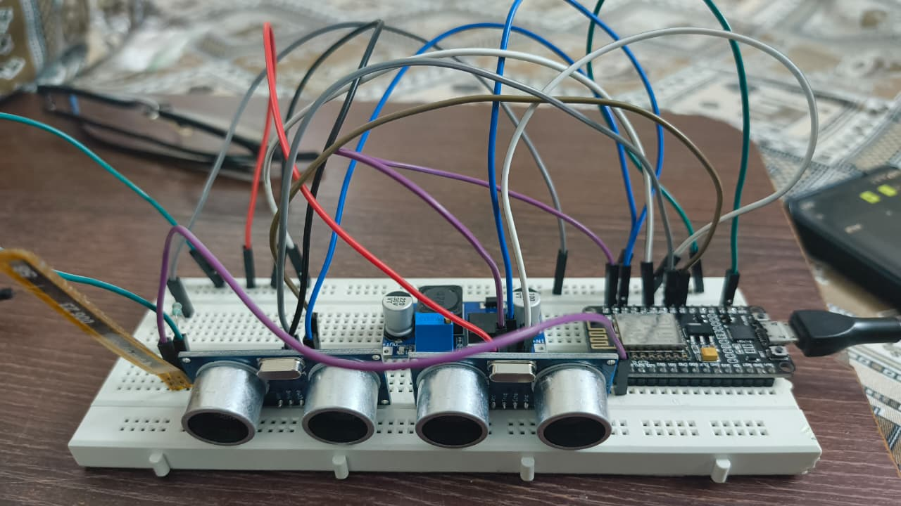
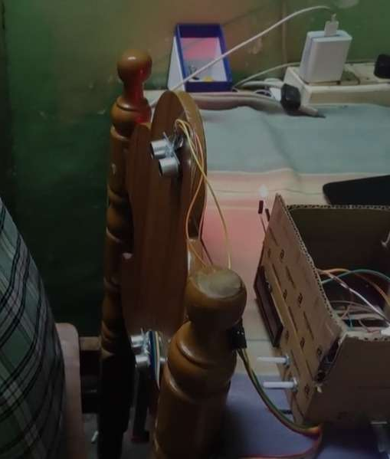
Work Done
Hardware Setup
ESP8266 with:
  Flex Sensor → ADC pin A0
  Ultrasonic Sensors → GPIO 12, 14, 13, 15
  LM2596 Boost Converter
      Software Implementation
      5-sample averaging for noise reduction
      Flex sensor value mapping: 275 - average
      Ultrasonic difference calculation for posture detection
      Decision tree classification (placeholder logic)
      WiFi connection to Blynk with authentication token

Slide 8
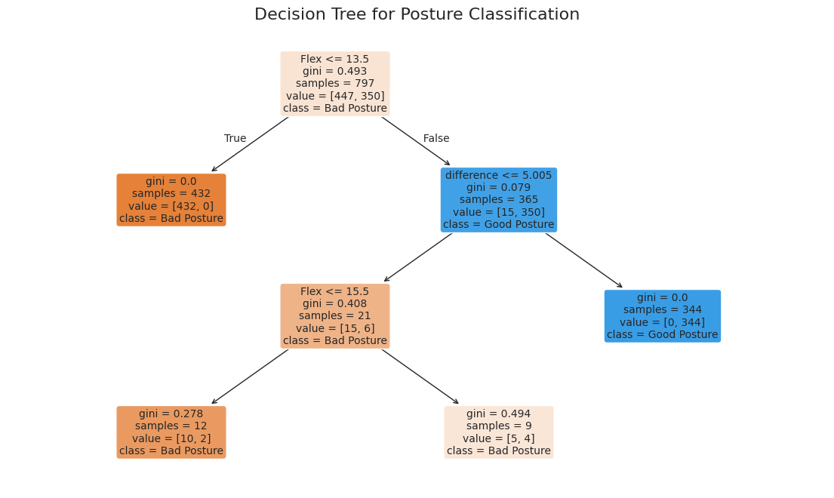
Decision Tree (Used for Posture Classification)
What is Decision Tree?
A supervised machine learning model that makes decisions using a tree-like structure of if–else rules. It splits data based on feature thresholds until it reaches a classification result.

Slide 9
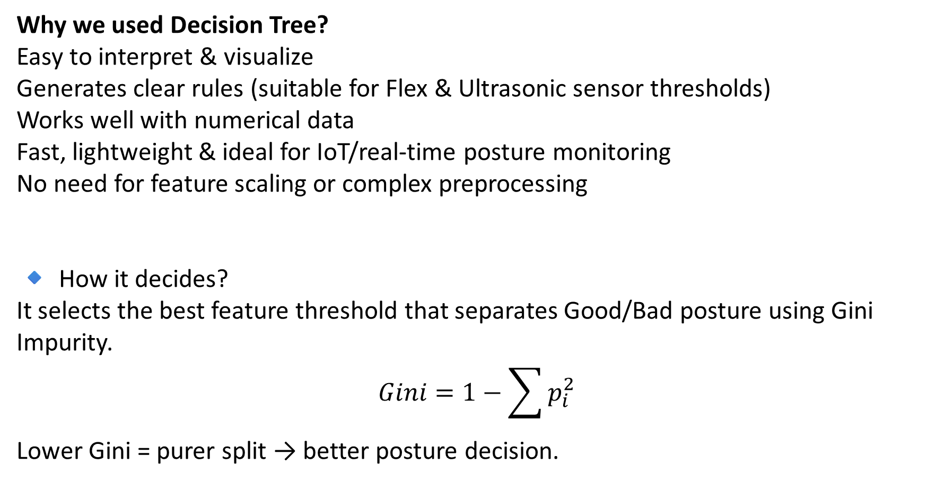
Why we used Decision Tree?
Easy to interpret & visualize
Generates clear rules (suitable for Flex & Ultrasonic sensor thresholds)
Works well with numerical data
Fast, lightweight & ideal for IoT/real-time posture monitoring
No need for feature scaling or complex preprocessing
🔹 How it decides?
It selects the best feature threshold that separates Good/Bad posture using Gini Impurity.
$$Gini=1−\sum{p_{i}^{2}}$$
Lower Gini = purer split → better posture decision.

Slide 10
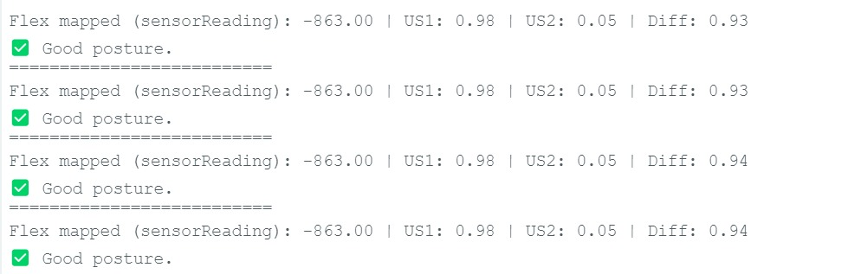
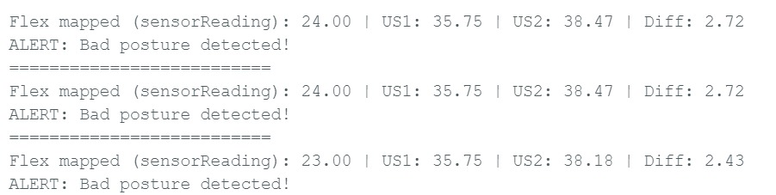
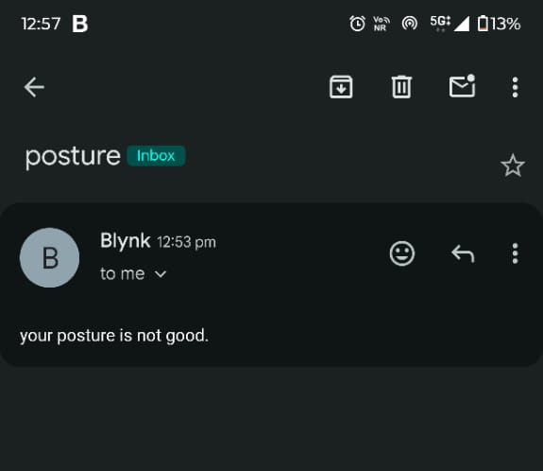
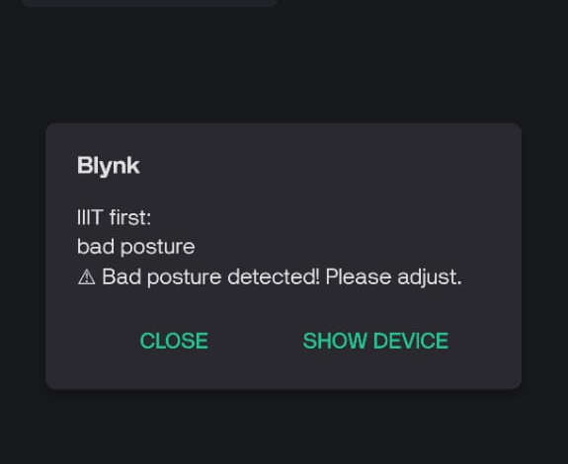
Results Obtained

Slide 11
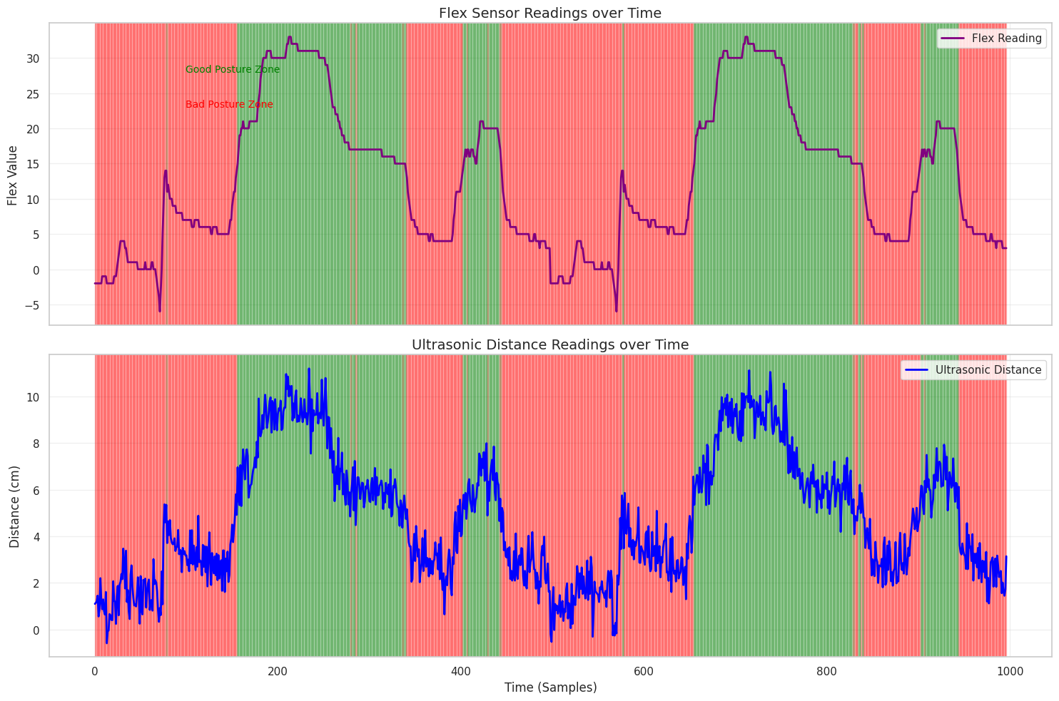

Slide 12
Conclusion
The system successfully monitors sitting posture in real-time using ESP32 with flex and ultrasonic sensors.
It alerts users instantly through Blynk, ensuring immediate posture correction.
Low-cost, privacy-safe and comfortable alternative to camera-based solutions.
Works without body-worn devices, making it user-friendly for daily use.
Decision Tree algorithm helped determine thresholds for accurate classification.
Around 1000 test samples showed consistent and reliable performance.
Portable, power-flexible and suitable for long study/office sessions.
Future refinement can lead to a commercial ergonomic product.

Slide 13
Future Scope
The current prototype focuses mainly on detecting forward slouching using flex and ultrasonic readings. There are several promising enhancements that could improve accuracy and functionality:
Machine Learning Upgrade:
Instead of fixed threshold detection, advanced ML/DL models can learn personal sitting patterns and adjust limits automatically for user-specific calibration.
Additional Sensors (Future Integration):
Adding MPU-6050 IMU, pressure sensors or stretch bands could help detect side bending, shoulder drop, twisting and neck tilt conditions for 360° posture analysis.
Mobile Application Dashboard:
An Android/iOS app with weekly posture analytics, graphs, calorie impact, and correction feedback can increase user engagement.
Cloud Data Storage:
Firebase/Thingspeak cloud integration could store long-term posture logs for progress monitoring and health assessment.

Slide 14
REFERENCES
Reference 1
L. E. Dunne et al., “Wearable monitoring of seated spinal posture,” IEEE Transactions on Biomedical Circuits and Systems, vol. 2, no. 2, pp. 97–105, 2008.
What this paper did:
Developed a wearable vest with accelerometers to track spinal posture.
Could detect bending and spinal curvature with good accuracy.
Main focus: continuous posture monitoring in daily life.
Limitations:
Intrusive (users must wear a vest).
Not comfortable for long-term use.
High cost → less suitable for everyday application.

Slide 15
Reference 2
H. Jeong and W. Park, “Developing and evaluating a mixed sensor smart chair system for real-time posture classification: Combining pressure and distance sensors,” IEEE Journal of Biomedical and Health Informatics, vol. 25, no. 5, pp. 1805–1813, 2020.
What this paper did:
Designed a smart chair with pressure sensors + ultrasonic distance sensors.
Achieved real-time posture classification (sitting upright, leaning, slouching).
Showed high accuracy in posture detection.
Limitations:
High implementation cost due to multiple pressure sensors.
System complexity makes it hard to scale or deploy widely.
Limited to fixed chair design.

